Slide 1
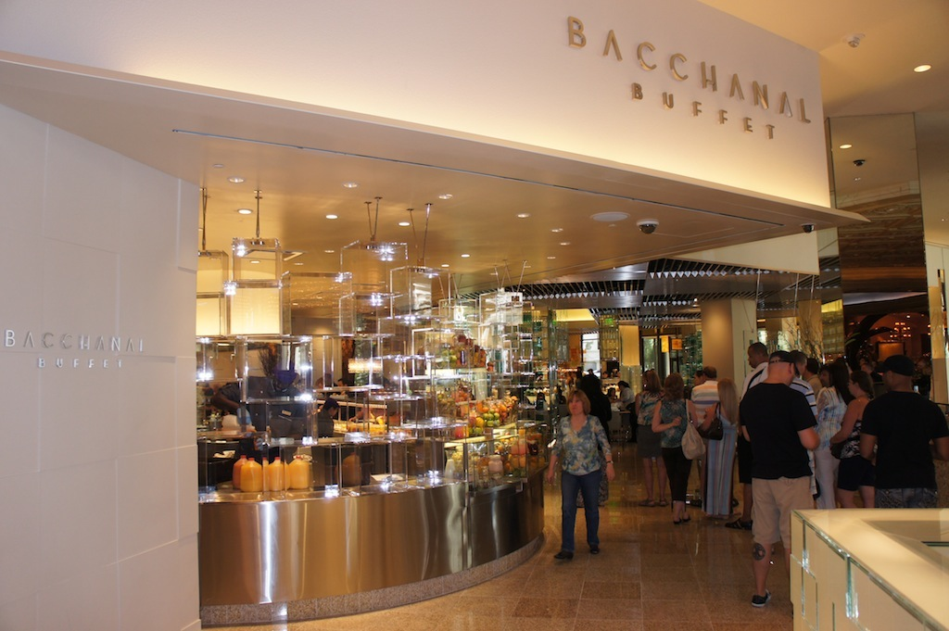
REVIEW ANALYSIS
OF BACCHANAL BUFFET
SWEET MELON CONSULTING
MENGTIAN HU, JIAYING LI, ANYU LI, YISHI LU, DONGYUE WANG, YUCEN ZHAO

Slide 2

AGENDA
1
Problem Statement
2
Buffet Market at Las Vegas
3
Bacchanal Buffet Yelp Review Analysis
RANDOM FOREST| LOGISTIC REGRESSION | TF-IDF SCORE
4
Competitor Yelp Review Analysis
5
Our Recommendations

Slide 3
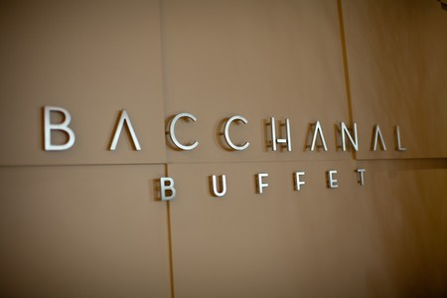

PROBLEM STATEMENT
SWEET
MELON
CONSULTING
Help them to attract more customers and
increase market share

Slide 4
OUR APPROACH
94% of diners will choose a restaurant based on online reviews according to smallbiztrends.
Thus, we decided to use Yelp Reviews to help Bacchanal assess its business performance and potential improvements to make.

Slide 5
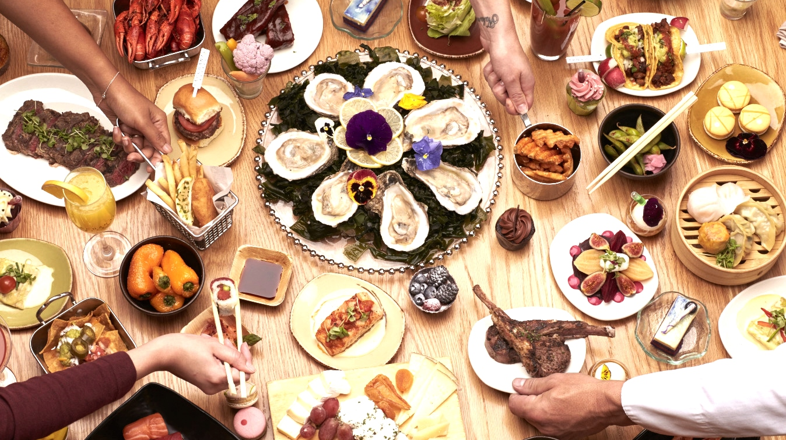
BUFFET MARKET
IN LAS VEGAS

Slide 6

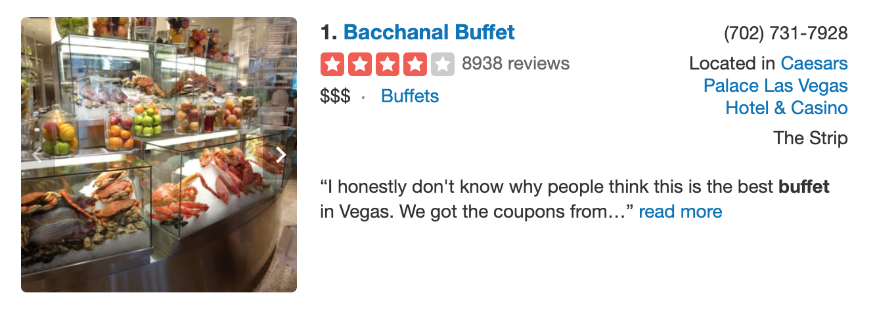
BUFFET MARKET IN LAS VEGAS
1534
Buffets
in Las Vegas
No.1

Slide 7
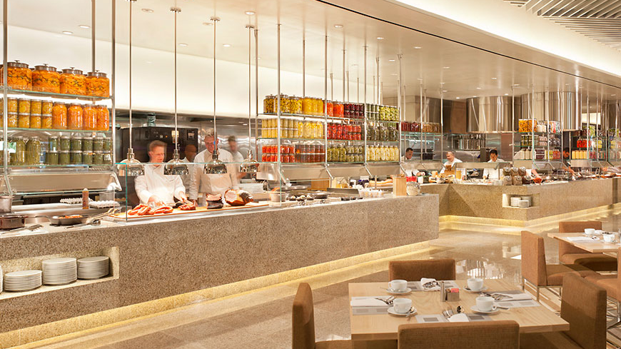
BACCHANAL REVIEW ANALYSIS

Slide 8


BACCHANAL REVIEW DATASET OVERVIEW
8568 TOTAL REVIEWS
5675 Reviews
2893 Reviews

Slide 9
LOGIC MAP FOR REVIEW ANALYSIS
Random Forest
Approach
Logistic Regression Approach
Figure out which word will significantly impact the review rating
Deep Dive
TF-IDF Score
Approach
Review Analysis

Slide 10
CLASSIFCATION AND LOGISTIC MODEL
Random Forest
Logistic Regression
Classify good reviews by the number of times the word mentioned in the reviews
Feature Importance
abs(coefficient) /max(abs(coefficient)
Worst>=1
yes
no
Which word plays important role in classifying positive and negative reviews
Line >= 3
Mediocre >= 1
... ...
poor
good
poor
good

Slide 11
WORD LIST FROM TWO MODELS
Seafood, dessert, option, sushi, overrated, waste, dirty, bland, variety, steamed, management, beautiful, salty, gelato, beer, tasteless, price, fresh, sum, tough…

Slide 12
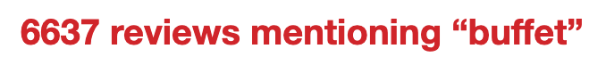
TF-IDF SCORE
Frequency of a term adjusted for how rarely it is used in a collection of reviews
Example
High frequency but not really important
Low frequency but important
Notes:
By this method, we can consider term with no bias

Slide 13
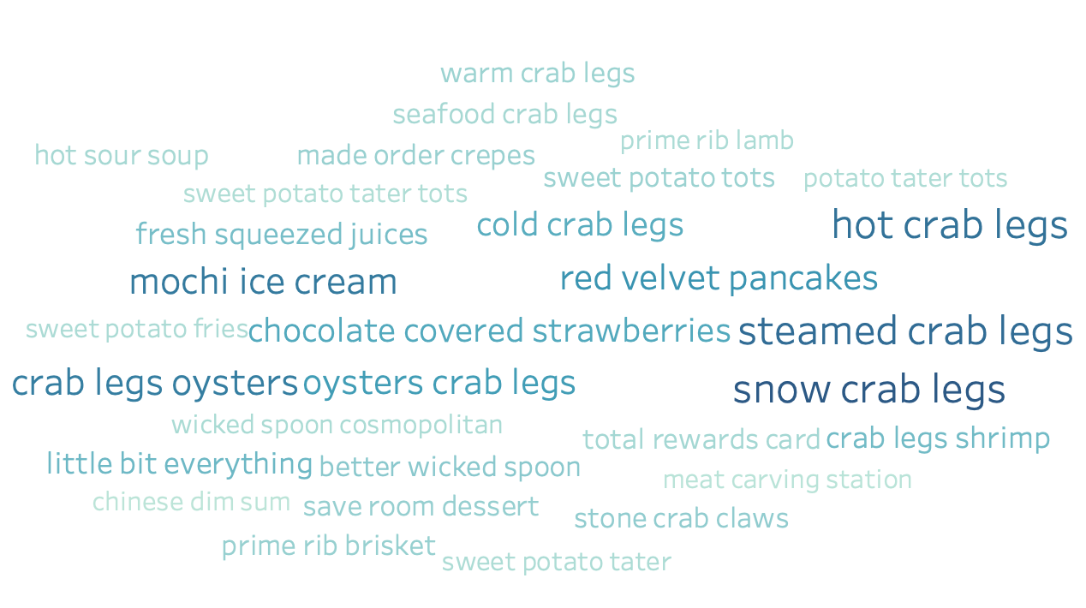
GOOD REVIEWS WORDCLOUD
Notes:
Using this measurement, we get the top 30 highest scored word combinations and get the word cloud of it, we can see most important words are mainly food, crab legs, pancakes, seafood, we can make assumptions that the reason Baccanal buffet is good is because of their food, in order to verify this assumption, we look back to the reviews.

Slide 14


EXAMPLES OF GOOD REVIEWS
“Everything here is just so good! I always try to make sure I get to try a little bit of everything. …… I really enjoyed the crab legs, taco station. ”
“The brisket was better than most BBQ restaurants in town and the rib eye steak was cooked to a perfect medium rare.”
“From the main dishes like the Chinese dishes, Thai dishes, Japanese dishes, Italian, dim sum, beef ribs, prime rib, seafood to the desserts……. I believe the quality and selection is worth the price!”
Notes:
These are the example that contains those high scored word combinations

Slide 15
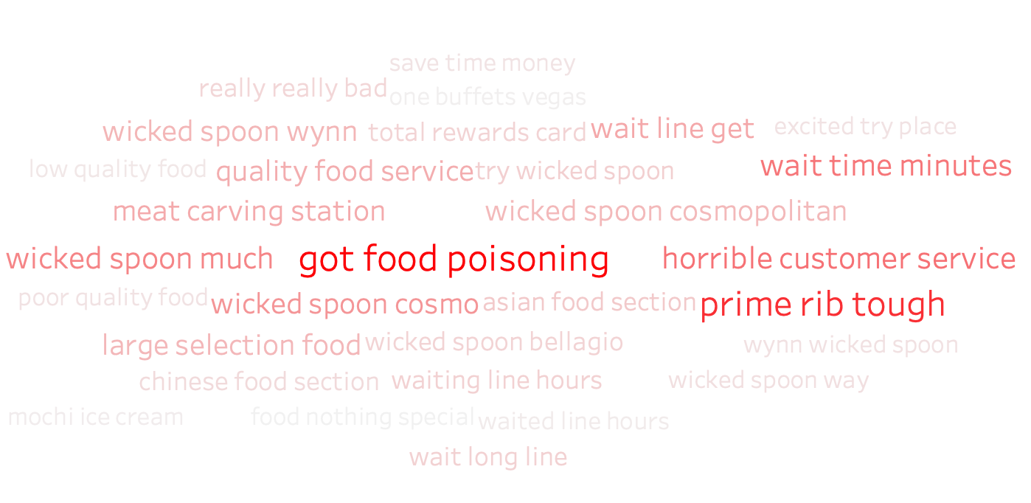
POOR REVIEWS WORDCLOUD
Notes:
Using similar methodology, we get the top 30 word combinations for poor reviews, some of them complained …..

Slide 16
EXAMPLES OF POOR REVIEWS
“Not a fan of the service or the management. ……they will be slow to keep your glass topped up. Also, the music is HORRIBLE and too loud. ”
“First of all, their wait system sucks. Their automated kiosks are a joke. And with the amount of ppl they are getting, I'm not surprised that the system is not working.”
“This place is over rated… the food made most of the people in our party run to the restroom (food poisoning, ahhhh). All for $55, what a bargain? Not.
“……. This place can't hold a candle to Wicked Spoon. I think even the buffet at the Wynn is better…….”
Notes:
Know yourself but know your enemys better

Slide 17
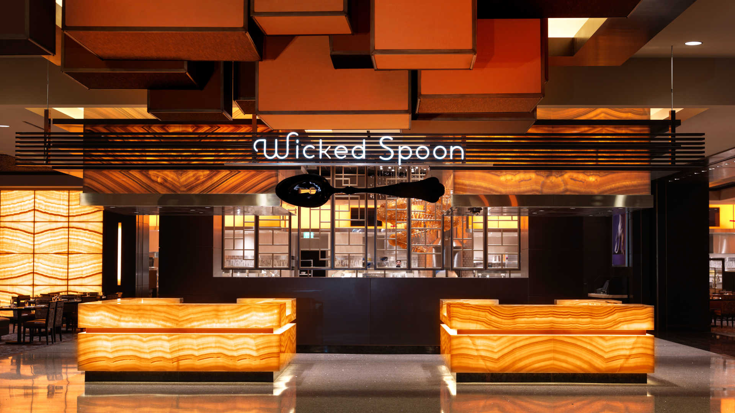
WICKED SPOON REVIEW ANALYSIS
Notes:
Analyze this major competitor
help us know what bakenao should improve and what is its competitive advantage over its competitors
We apply the same tf-idf approach to process the good and bad reviews and get the top 30 terms with high scores.

Slide 18
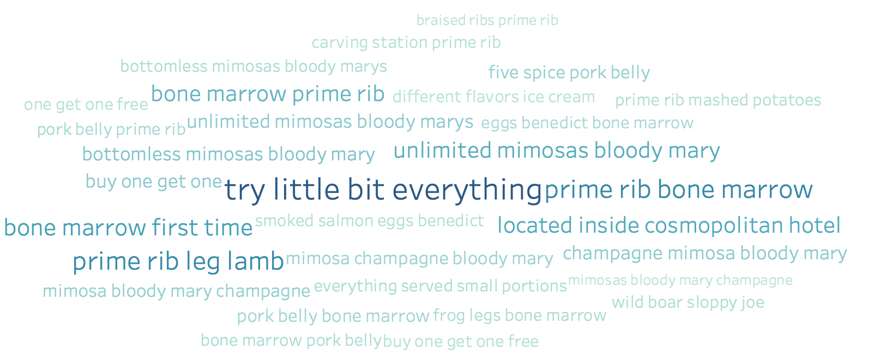
GOOD REVIEWS WORDCLOUD
Notes:
Prime ribs, bloody marry, champaign, buy one get one free appears to be the most frequent and important terms

Slide 19
EXAMPLES OF GOOD REVIEWS
“Everything was amazing!! We ate at dinner time and the things that I still think about are the prime rib, mac and cheese, bone marrow, fresh baked cookies, and a lot of other desserts.”
“... $35 and for another $10, you can add on bottomless champagne, mimosa, and bloody mary’s. ”
“Got a buy one get one free coupon for Wicked Spoon buffet from United Airlines when I was flying into Vegas. ”
“Forever fat. The desserts looked sooo good. They had this huge display of gelato ice cream with different flavors. ”
Notes:
We refer back to the original reviews to understand what aspects of the terms satisfied the customers

Slide 20
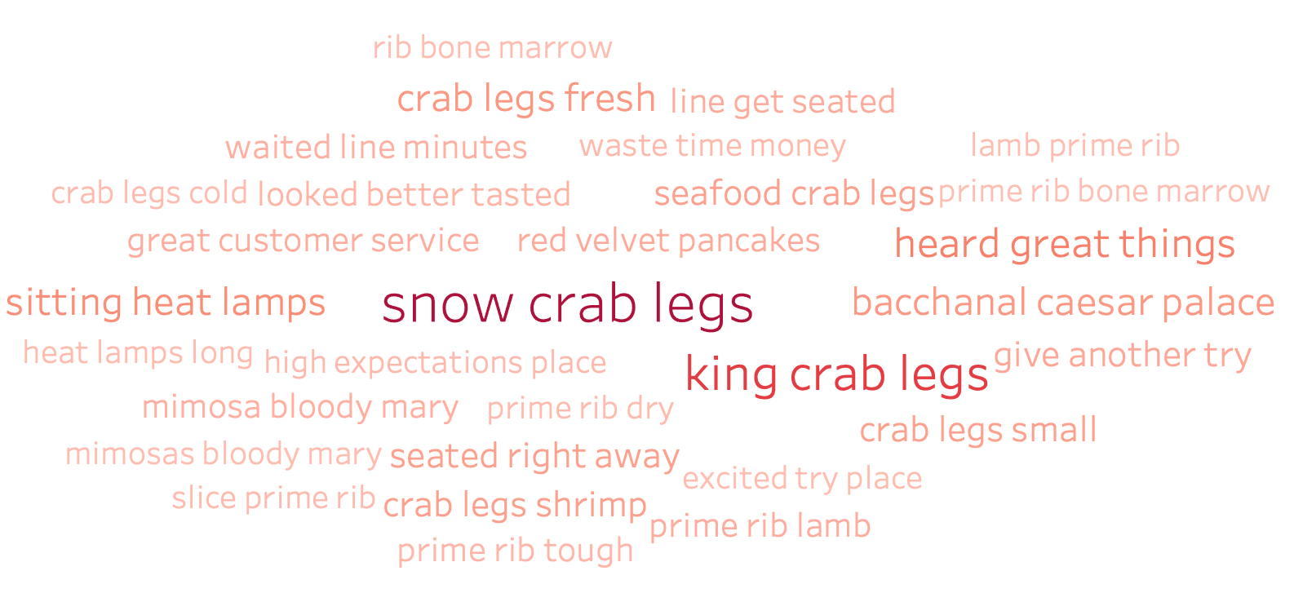
POOR REVIEWS WORDCLOUD
Notes:
Crab legs, prime rib, waited lines, not as what expected

Slide 21
EXAMPLES OF POOR REVIEWS
“The main attraction such as the "skinny" crab legs were not self serve so for literally 3-4 legs you had to go up each time to the grumpy guy serving it. ”
“The crab legs were not fresh and small comparing to other buffets. ”
“Rather, what we saw were dry prime rib, flavorless shrimp balls and lots of generic foods you'd find at any buffet up and down the strip.”
“Wicked Spoon needs to pick themselves up again, especially with bacchanal competing from caesar! I'm not sure I'll be back here again when there is 3 times the selection at bacchanal.”
Notes:
In comparison, bakenao offered unlimited fresh crab legs, advantage
Unstable taste quality for prime rib
We have more food choices

Slide 22
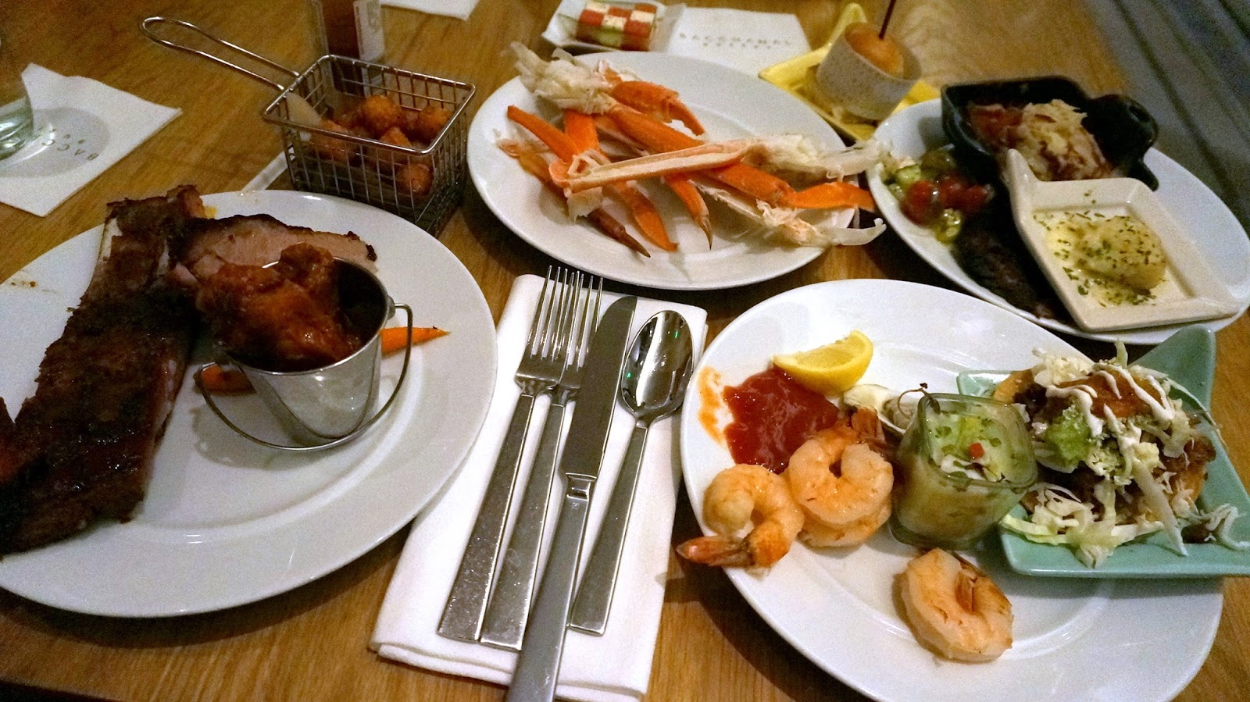
RECOMMENDATION

Slide 23
RECOMMENDATION FROM SWOT ANALYSIS
S
W
T
O
Wait system
Management
Food safety
Taste quality
Selection variety
Price competition
Dessert variety
Unique dish
Partnership
Notes:
For example Partner with AA to offer promotion. Etc.
Happy hour
Wicked spoon is innovative in its dishes - Chef choices/specialty

Slide 24

RETURN ON INVESTMENT
Better rating on yelp Higher buffet traffic
Higher restaurant traffic Larger market share
Notes:
Achieved more than 70% AUC in the random forest model
This restaurant

Slide 25
Thank You!
Q&A

